Slide 1


SMART INDIA HACKATHON 2025
TITLE PAGE
Problem Statement ID – 25103
Problem Statement Title- ERP-based Integrated Student Management system
Theme- Smart Automation
PS Category- Software
Team ID-
Team Name (Registered on portal)- Ednext

Slide 2
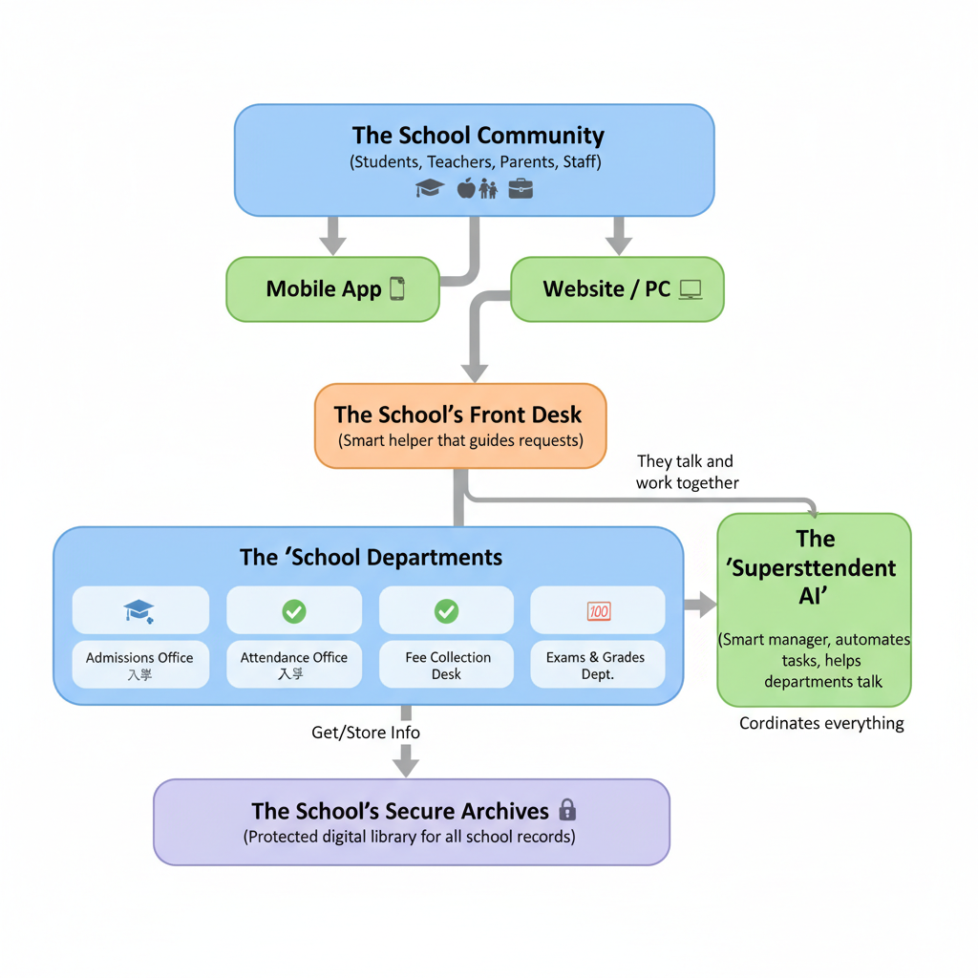
IDEA
Ednext
Vidya, an AI-Agentic ERP, uses an Agent-to-Agent (A2A) protocol. This system enables autonomous AI agents to seamlessly communicate and execute tasks, transforming static educational ERPs into dynamic, intelligent management systems for Indian institutions.
Problem
Interfaces: Outdated UIs, poor mobile-web sync, and non-intuitive navigation lead to user frustration.
Data Silos: Modules lack API integration, causing fragmented data and manual reconciliation.
Limitations: Poor scalability for multi-campus setups and inadequate data security features.
Solution
Unified Access: Mobile-first apps & responsive web portal for easy, intelligent user experience.
Smart Automation: AI agents using A2A protocol break data silos, automating cross-module workflows.
Verifiable Security: An open-source blockchain (Hyperledger Fabric) secures marksheets, attendance, and exam data, making them tamper-proof and verifiable..

Slide 3
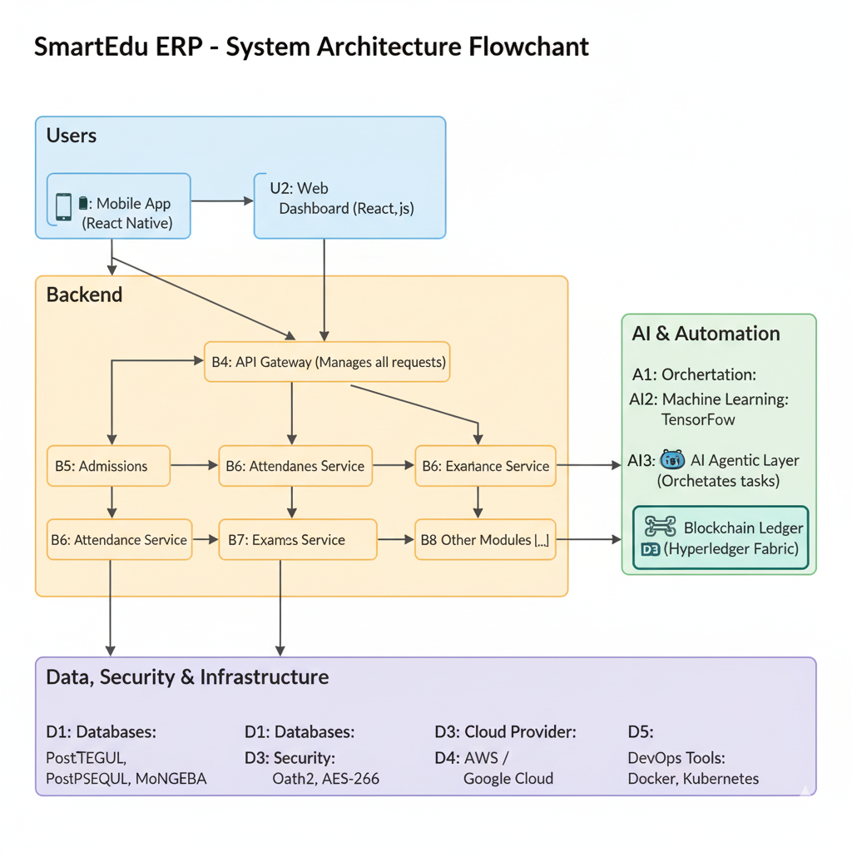
TECHNICAL APPROACH
Ednext
CORE ARCHITECTURE & METHODOLOGY
Architecture: We will use a cloud-native microservices architecture for scalability and modularity.
Frontend: A cross-platform framework (React Native) will deliver a unified mobile and web experience.
Backend: Decoupled Node.js services will manage individual modules (Admissions, Finance, etc.).
AI Core: An AI agentic layer (LangChain) will orchestrate workflows between services using the A2A protocol.
Data Integrity: An open-source blockchain (Hyperledger Fabric) will create an immutable, auditable trail for critical student records.
Methodology: An agile, phased approach will be used, starting with an MVP and scaling up.

Slide 4
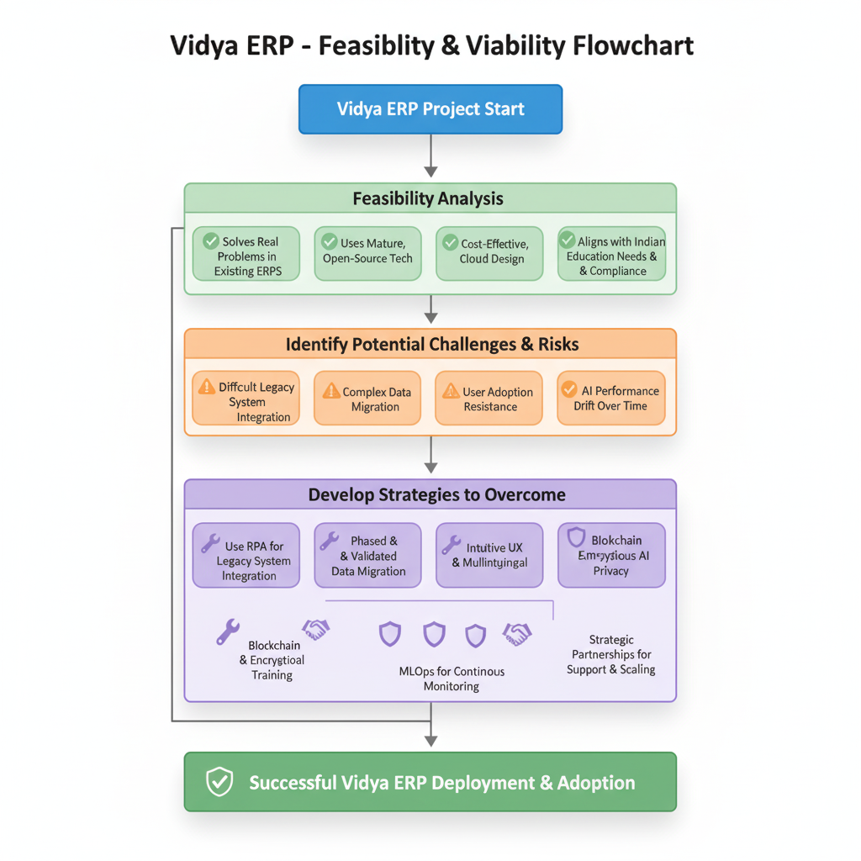
FEASIBILITY AND VIABILITY
Ednext
Feasibility Analysis
Tech: Uses popular, free tools like React, Node.js, and Hyperledger.
Problem-Solver: Directly fixes data-sharing and UX issues for Indian schools.
Scalable: Flexible design grows easily from small colleges to large universities.
Potential Challenges & Risks
Integration: Connecting to old school software is complex; data migration risky.
User Adoption: Staff may resist new systems; data privacy is a key concern.
Maintenance: AI needs constant updates; securing long-term resources is tough.
Strategies to Overcome Challenges
Smart Tools: Use automation (RPA) for old systems; migrate data carefully.
User Focus: Offer simple, multilingual training; blockchain ensures data trust.
Sustainment: Automate AI monitoring (MLOps); build strong partnerships for support

Slide 5
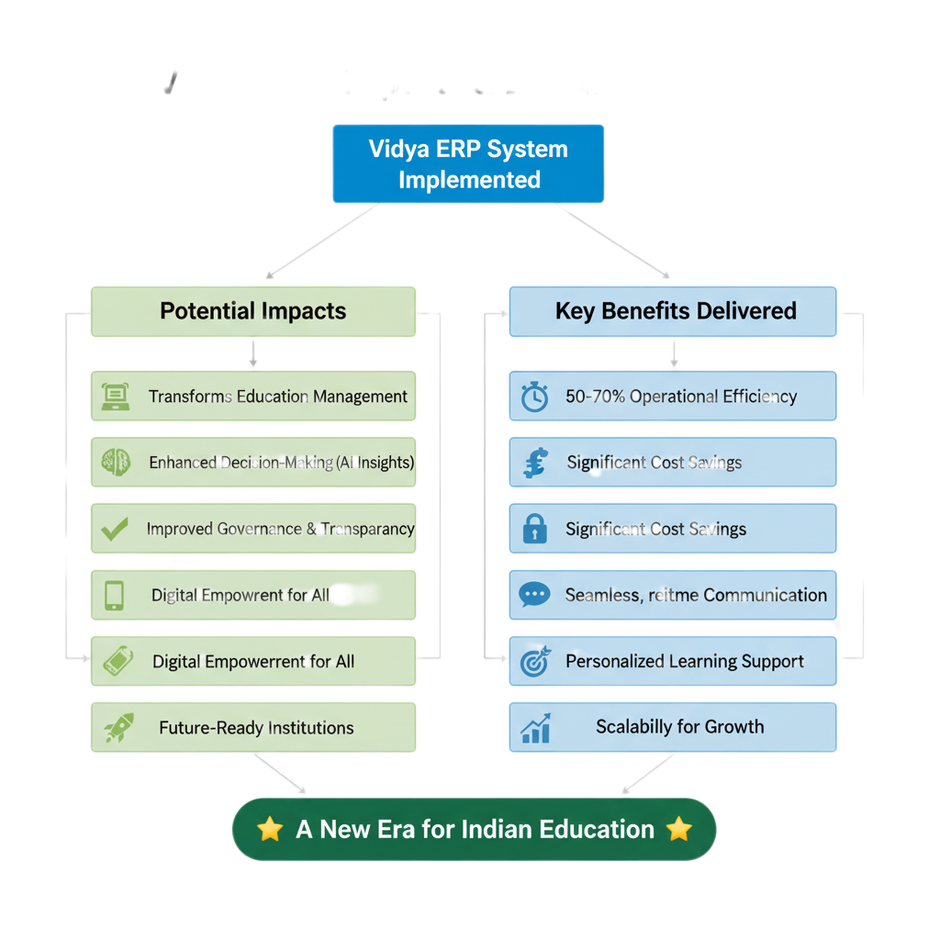
IMPACT AND BENEFITS
Ednext
Potential Impacts
Transformation: Drives digital transformation from static systems to dynamic ERPs.
Analytics: Provides predictive analytics for data-driven school management.
Transparency: Establishes operational transparency with secure, auditable logs.
Empowerment: Empowers users with an accessible and user-centric UI/UX.
Key Benefits
Automation: Delivers workflow automation, on whatsapp and our mobile application
Security: Secures records with immutable ledgers, ensuring verifiable data integrity.
Communication: Creates a unified platform for real-time stakeholder communication.
Intervention: Enables ML-driven interventions by identifying at-risk students.

Slide 6
RESEARCH AND REFERENCES
Edunex
Samarth ERP Documentation
Official Docs: https://docs.samarth.ac.in/docs/intro/introduction/ (Comprehensive documentation covering installation, modules, APIs, and system architecture
Official Samarth Portal: https://samarth.edu.in (Main website for Samarth ERP with overview, news, and rollout information)
Samarth eGov Smarter Automation Engine: https://scdn.samarth.ac.in
AI Agentic Frameworks (LangChain, TensorFlow)
LangChain educational resources: https://docs.n8n.io/advanced-ai/langchain/langchain-learning-resources/
Top agentic AI ERP use cases: https://research.aimultiple.com/agentic-ai-erp/
Technical research paper on arXiv explaining architecture, training, and performance: https://arxiv.org/abs/2509.05276
Project introduction and documentation with setup and deployment info on GitHub: https://github.com/BICLab/SpikingBrain-7B (README and folder structure

Slide 7
IMPORTANT INSTRUCTIONS
Please ensure below pointers are met while submitting the Idea PPT:
Kindly keep the maximum slides limit up to six (6). ( Including the title slide)
Try to avoid paragraphs and post your idea in points /diagrams / Infographics /pictures
Keep your explanation precise and easy to understand
Idea should be unique and novel.
You can only use provided template for making the PPT without changing the idea details pointers (mentioned in previous slides).
You need to save the file in PDF and upload the same on portal. No PPT, Word Doc or any other format will be supported.
Note - You can delete this slide (Important Pointers) when you upload the details of your idea on SIH portal.

